Slide 1
Copy Tool
GW 10
Report
Data
Data
Data
Data
Data Upgrade Compare Tool(s)

Slide 2
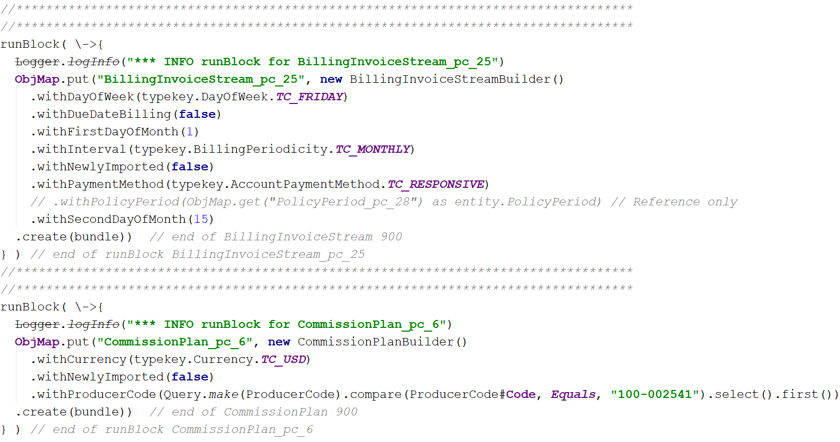
XML
Hard to read
Hard to edit
Databases
Need tools
Guidewire Export / Import
Can only run once
Brings ID’s with (PublicID, PolicyNumber)
Spreadsheet
Column Data Centric
Manual New Columns
Extraction / Injection
Automatically detects Data Model Changes
Re-Runable
Generates all new id’s
Uses existing users and data
No DB drop(s)
Editable / Readable
Portable
Traceable to the original data
Order of Creation
Uses a unique fingerprint for the information
Easy to Edit information
A logical unit of data
References are included to related data
A logical unit of data

Slide 3
XML
Hard to read
Hard to edit
Databases
Need tools
Guidewire Export / Import
Can only run once
Brings ID’s with (PublicID, PolicyNumber)
Spreadsheet
Column Data Centric
Manual New Columns
Extraction / Injection
Automatically detects Data Model Changes
Re-Runable
Generates all new id’s
Uses existing users and data
No DB drop(s)
Editable / Readable
Portable
Traceable to the original data

Slide 4

Data Verification Approaches
Source Staging
SI Staging
GW Staging
Migration
Data
Data
Data
Data
Data
Data
ETL
Data
ETL
Data
ETL
Data
GW Data Integrity Check and Load
Copy Tool
GW 10
GW 10
Report
Legacy
Data Extraction
Data
Data
Manually Enter Into GW10
Data
Data
Data
Data
Data
Data
Data Injection
Data
Data Compare Tool(s)
Reconciliation
Execute Value Comparisons (for 20+ value elements) and Volumetric Analysis for each stage of data migration
Financials and Out of Balance reports
Business rules are validated in each stage to identify issues early in the process
Tools Deployed: SQL Scripts and MS Office
Reconciliation

Slide 5
Data Verification Process
GW Staging
Migration
Manually Enter Into GW10
Data
Data
Zensar ETL
Data
GW Data Integrity Check and Load
Copy Tool
GW 10
Report
Legacy
Data
Data
Data
Data
Data
Data
Data
Data Upgrade Compare Tool(s)
Validation
Upgrade Copy Tool(s)
Upgrade Injection Tool(s)

Slide 6

Guidewire Infrastructure
Business SME
Database Server
GW Release Candidate with
Some GW Data
OOTB 10.0.x
with
GW Sample Data
Reviewer(s)
Bit bucket
Pull Request
Demo GW 10.0.x
GW Systems and Services
Performance
Testing
Non-Integrated Dev (unit test)
Developer(s)
Continuous testing (automation)
Training
Local Dev
Source Control GIT / GITHUB
Integrated Dev
Test
Training
GW 10.0.x
Wiki
DB Upgrade
Data Migration
Model Office
RallyDev
Data Mappers
Defect Tracking
Production

